Slide 1

Machine Learning
Session 23 - T
Explainable AI (XAI)
Ciência de Dados Aplicada
2023/2024

Slide 2
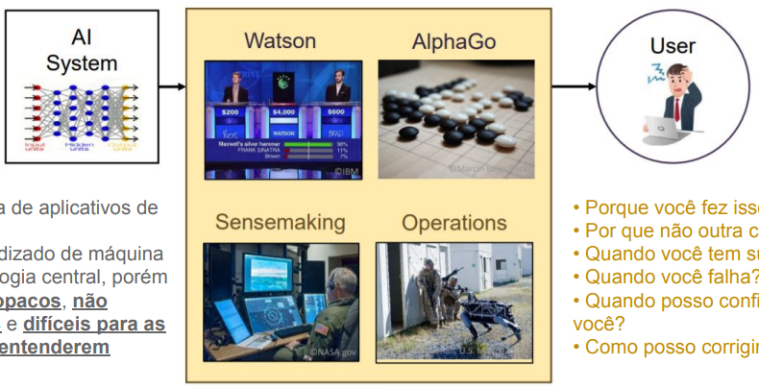
Explainable AI (XAI) Motivation
• New era of AI applications;
• Machine learning is the core technology, but they are opaque, non-intuitive, and difficult for people to understand.
•Why did you do that?
•Why not something else?
•When do you succeed?
•When do you fail?
•When can I trust you?
•How do I correct an error?
Explainable AI (XAI)
Session 23

Slide 3
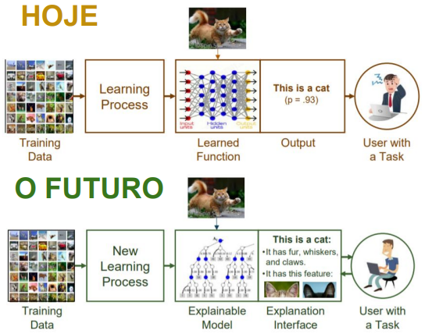
XAI Objective
•Why did you do that?
•Why not something else?
•When do you succeed?
•When do you fail?
•When can I trust you?
•How do I correct an error?
•I understand why.
•I understand why not.
•I know when you will succeed.
•I know when you will fail.
•I know when to trust you.
•I know why you made a mistake.
Explainable AI (XAI)
Session 23

Slide 4
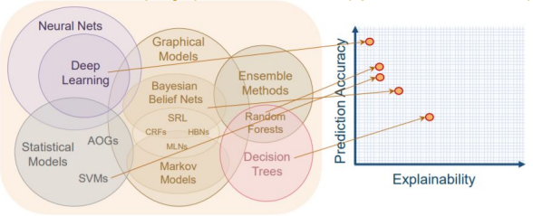
Performance Vs Explainability
Challenge: Develop machine learning techniques that produce more explainable models while maintaining a high level of performance.
Explainable AI (XAI)
Session 23

Slide 5
What is a good explanation?
Explanation not only answers "why this", but also "why this instead of that"!
Q: “Why did Jane get the promotion (while Bob didn’t)?”
A1: “Jane completed her project successfully.”
But John also completed his project successfully!
That doesn’t explain why she got the promotion!
A2: “Jane completed her project successfully and consistently demonstrated leadership skills.”
Bob struggled with leadership, so this explains why Jane got the promotion and John did not.
Explainable AI (XAI)
Session 23

Slide 6
What is a good explanation?
Explanation must be based on relevant information!
Q: “Why did Jane get the promotion (while Bob didn’t)?”
A1: “Jane completed her project successfully and wore glasses.”
But John also completed his project successfully, and wearing glasses shouldn't affect the promotion decision.
That doesn’t explain why she got the promotion!
But how do we decide that wearing glasses is not relevant, even if it might be statistically significant?
Explainable AI (XAI)
Session 23

Slide 7
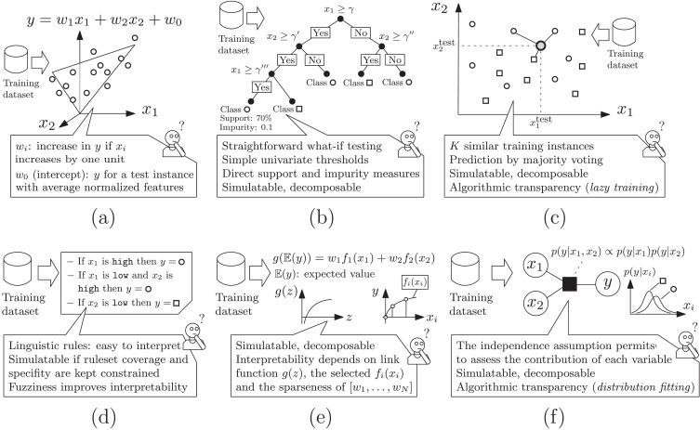
XAI in Various ML Models
(a) Linear regression; (b) Decision trees; (c) K-Nearest Neighbors;
(d) Rule-based Learners; (e) Generalized Additive Models; (f) Bayesian Models.
Explainable AI (XAI)
Session 23

Slide 8
XAI Approaches
Post-hoc:
Applied to already developed models in order to understand how one produces predictions for given input;
Prodice a separate algorithm which reads the end-to-end process.
In built:
Build the decision-making algorithm so that traces have whithin them the basis for explanation.
Explainable AI (XAI)
Session 23

Slide 9
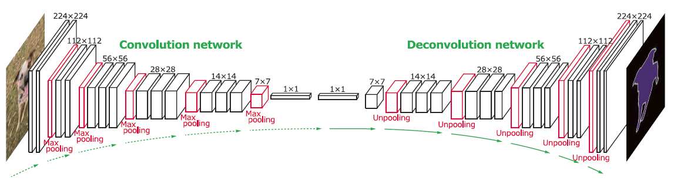
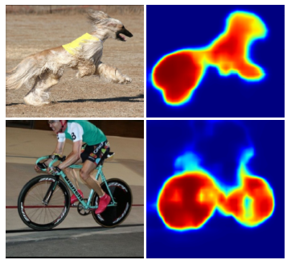
Post-hoc Techniques: Model-Specific
Post-hoc approach can be categorized into two approaches: model-specific and model-agnostic;
One popular technique used in model-specific approaches is to map back the output/prediction of a given input, through the learned model, see which parts of the input were discriminative for the output.
Explainable AI (XAI)
Session 23

Slide 10
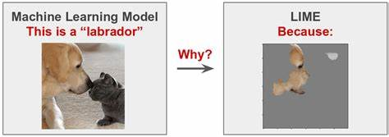
Post-hoc Techniques: Model-Agnostic
Techniques used in model-agnostic approaches (i.e. treat the original model as a black box) are categorized into two groups:
Explanation by simplification approaches aim to extract underlying rules or na approximate interpretable model from the original model.
“Local Interpretable Model-Agnostic Explanations” (LIME) system:
Explainable AI (XAI)
Session 23

Slide 11
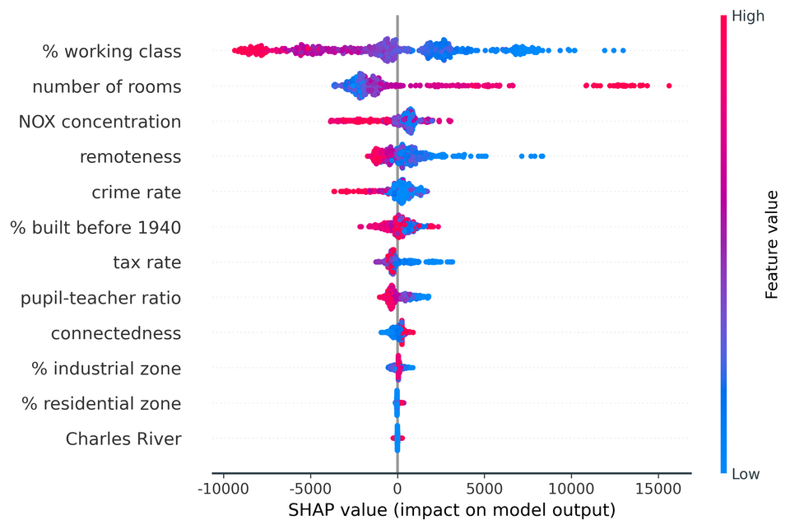
Post-hoc Techniques: Model-Agnostic
Techniques used in model-agnostic approaches (i.e. treat the original model as a black box) are categorized into two groups:
Feature relevance explanation approach aims to describe the functioning of an opaque model by measuring the influence and relevance of each feature on prediction output.
“Shapley additive explanations” (SHAP) system:
Explainable AI (XAI)
Session 23

Slide 12
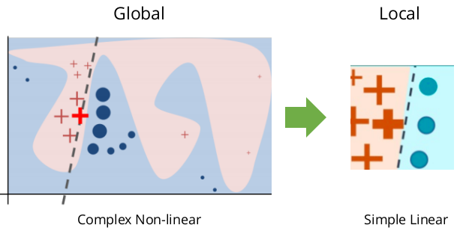
Local Interpretable Model-Agnostic Explanations (LIME)
LIME method was originally proposed by Ribeiro, Singh, and Guestrin (2016);
The key idea behind it is to approximate a global model (which is a black-box) by local models which are simpler and transparent.
Explainable AI (XAI)
Session 23

Slide 13
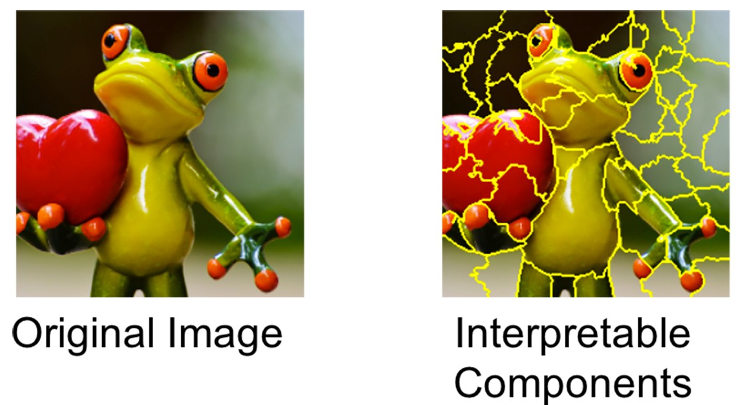
LIME Method
In order to be model-agnostic, LIME can't peak into the model. What LIME does to learn the behavior of the underlying model is to first perturb the input (e.g., removing words or hiding parts of the image);
For images, an original image is divided into interpretable components (contiguous superpixels).
Explainable AI (XAI)
Session 23

Slide 14
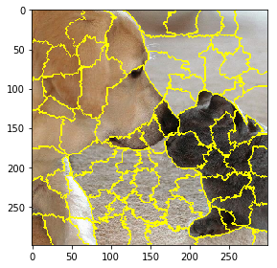
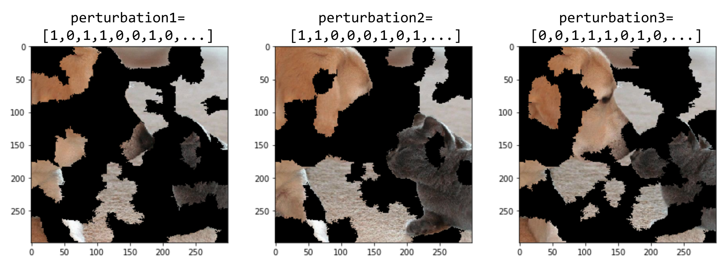
LIME Method
Original image segmented into 150 superpixels.
Explainable AI (XAI)
Session 23

Slide 15
LIME Method
Perturbation for text data:
For example, if we are trying to explain the prediction of a text classifier for the sentence:
“I hate this movie”, we will perturb the sentence and get predictions on sentences such as
“I hate movie”,
“I this movie”,
“I movie”,
“I hate”, etc.
Explainable AI (XAI)
Session 23

Slide 16
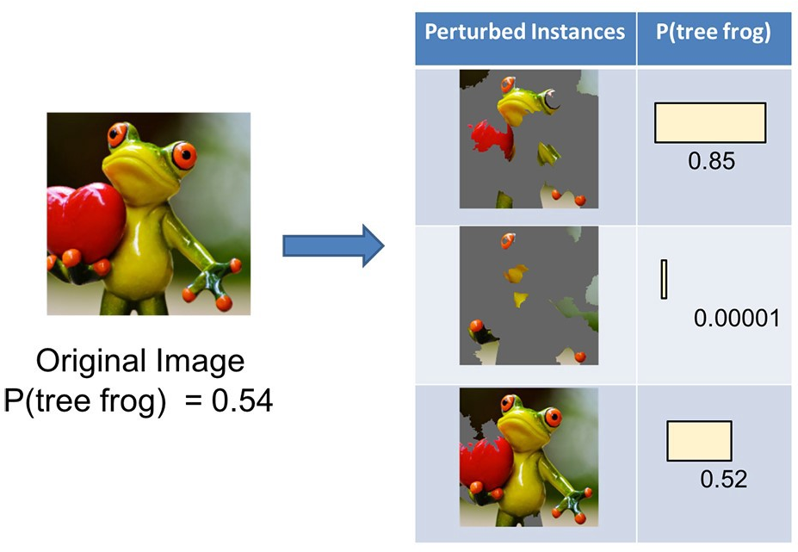
LIME Method
Then LIME run the perturbed data in the model and see how the predictions change.
Explainable AI (XAI)
Session 23

Slide 17
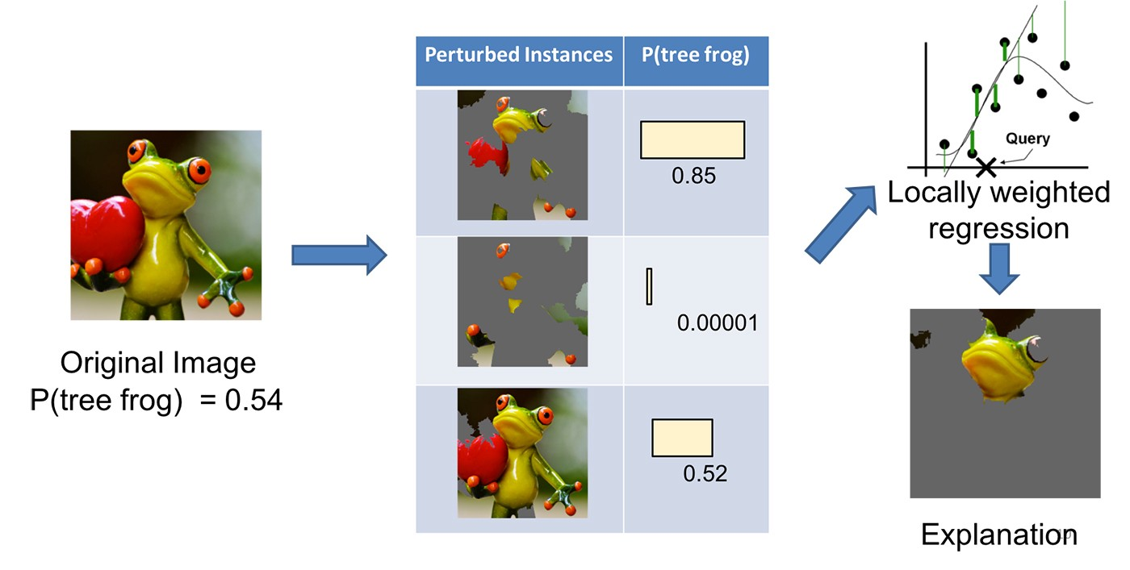
Resources
Then LIME weights these perturbed data points by their proximity to the original example and learns an interpretable model on those and the associated predictions.
Explainable AI (XAI)
Session 23

Slide 18
LIME Algorithm
Sample the locality around the selected single data point uniformly and at random and generate a dataset of perturbed data points with it’s corresponding prediction from the model we want to be explained.
Use the specified feature selection methodology to select the number of features that is required for explanation.
Calculate the sample weights using a kernel function and a distance function. (this captures how close or how far the sampled points are from the original point).
Fit an interpretable model (locally weighted linear regression) on the perturbed dataset using the sample weights to weigh the objective function (e.g. squared error).
Provide local explanations using the newly trained interpretable model.
Explainable AI (XAI)
Session 23

Slide 19
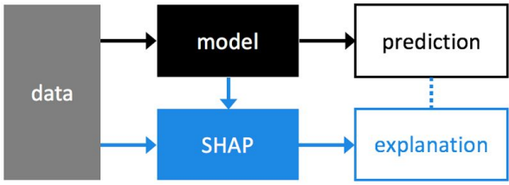
SHapley Additive exPlanations (SHAP)
Additive feature attribution method to explain the output of any ML model.
It assigns each feature na importance value for a particular prediction.
Explainable AI (XAI)
Session 23

Slide 20
SHapley Additive exPlanations (SHAP)
Additive feature attribution method to explain the output of any ML model.
It assigns each feature na importance value for a particular prediction.
Explainable AI (XAI)
Session 23

Slide 21
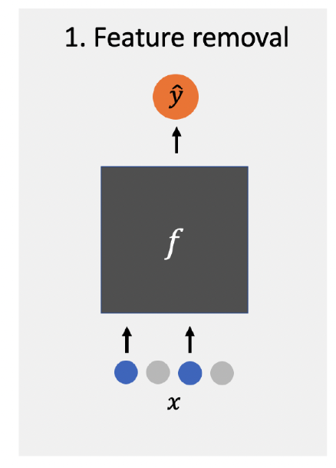
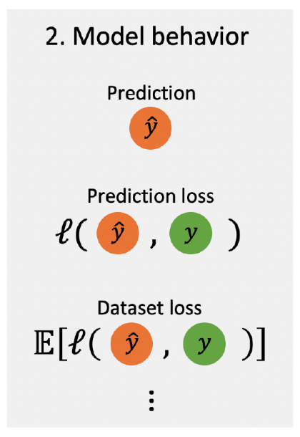
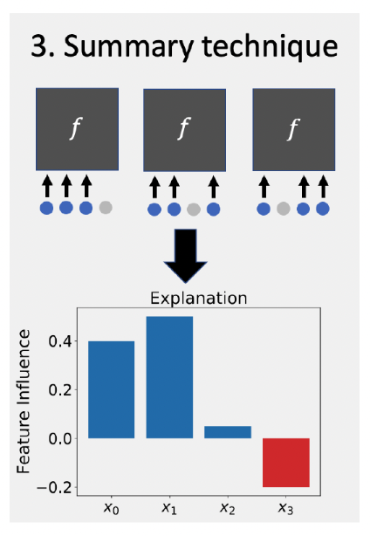
SHapley Additive exPlanations (SHAP)
The removal-based explanations framework
Explainable AI (XAI)
Session 23

Slide 22
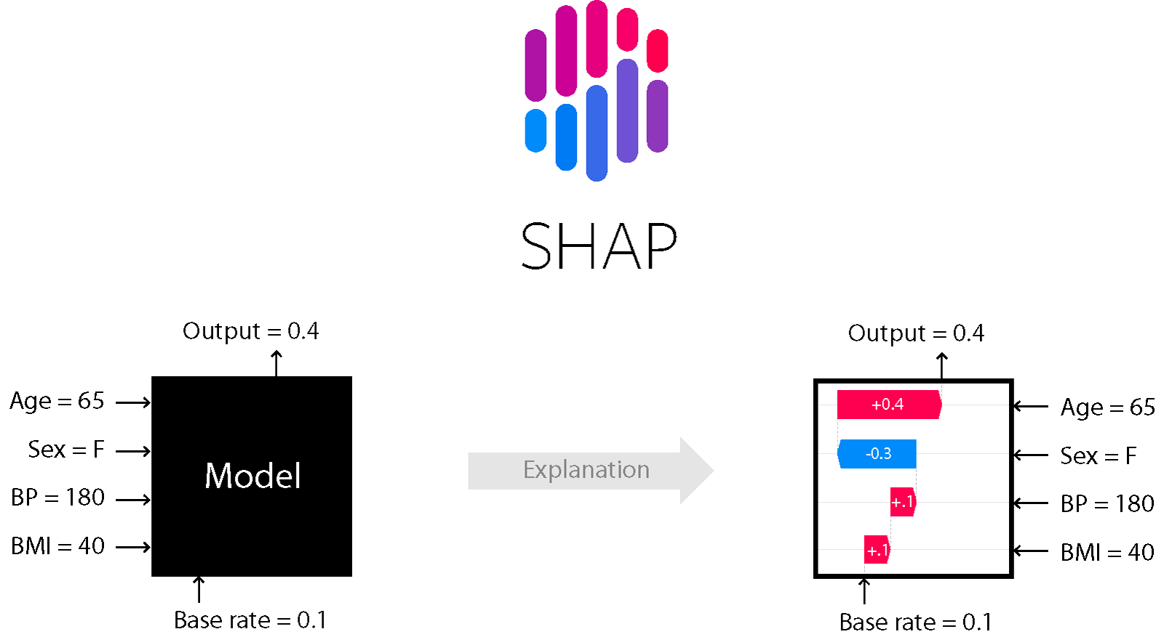
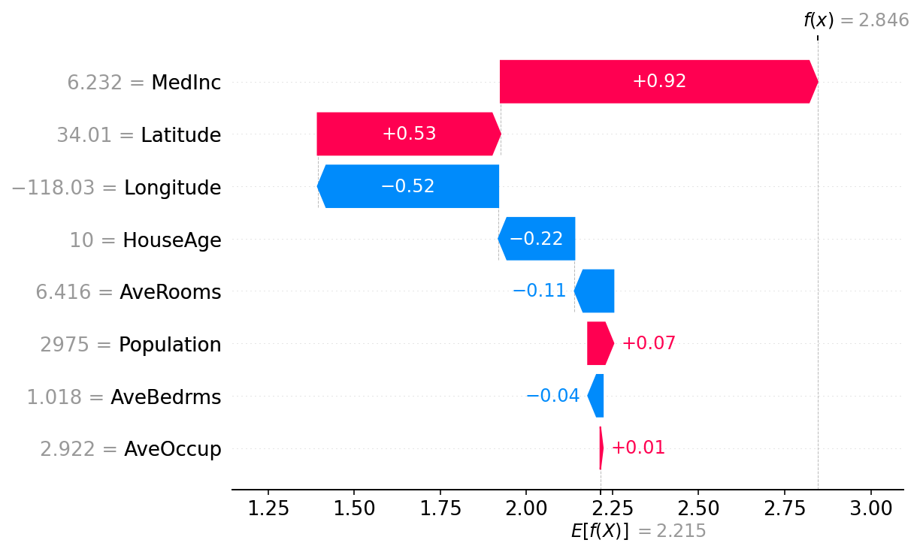
SHAP
Explainable AI (XAI)
Session 23

Slide 23
Resources
Ribeiro, M. T., Singh, S., & Guestrin, C. (2016). “Why Should I Trust You?”: Explaining the Predictions of Any Classifier (Version 3). arXiv. https://doi.org/10.48550/ARXIV.1602.04938
https://github.com/marcotcr/lime/tree/master
Lundberg, S., & Lee, S.-I. (2017). A Unified Approach to Interpreting Model Predictions (Version 2). arXiv. https://doi.org/10.48550/ARXIV.1705.07874
https://github.com/shap/shap
Explainable AI (XAI)
Session 23

